Slide 1
Project Title: Well 23T open up (Okoloma Battle plan)
Charter Template
Business Case/objectives:
This charter is aimed at restoration of Afam W23T production.
Currently the well cannot be produced due to liquid loading. Plan is to liaise with the CWI team to evacuate liquid in well and restore gas production of 45mmscf/d and also condensate production.
Potential Benefits & Measurement:
Gas production of 45mmscf/d
Critical Success Factors:
CWI mobilization plan
High-level Timeline:
L0-L1: 10 October 2018
L2: 05 Novemeber 2018
L3: 10 Novemeber 2018
L4: 31 August 2018
L5: 20 September 2018
Initiative End
Project Scope/Actions :
CWI mobilization to site
Evacuation of liquid in well
Well handover to asset team
Resume gas production
Team members:
Onoh Ebere
Agbiwe Odafe
CWI team

Slide 2
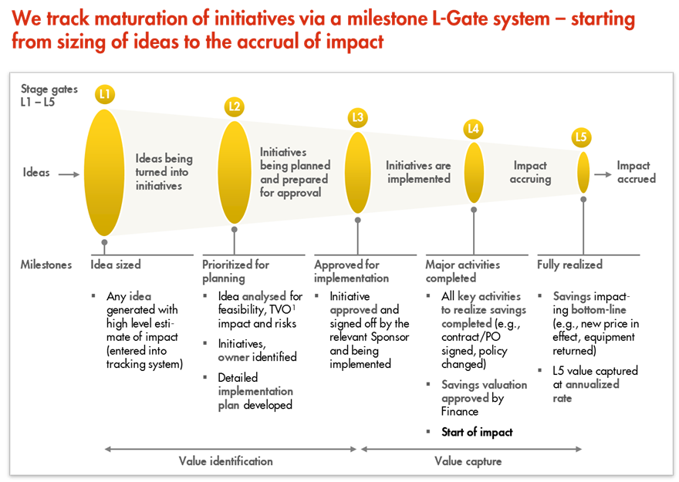
L1 – L5 Gates

